Slide 1
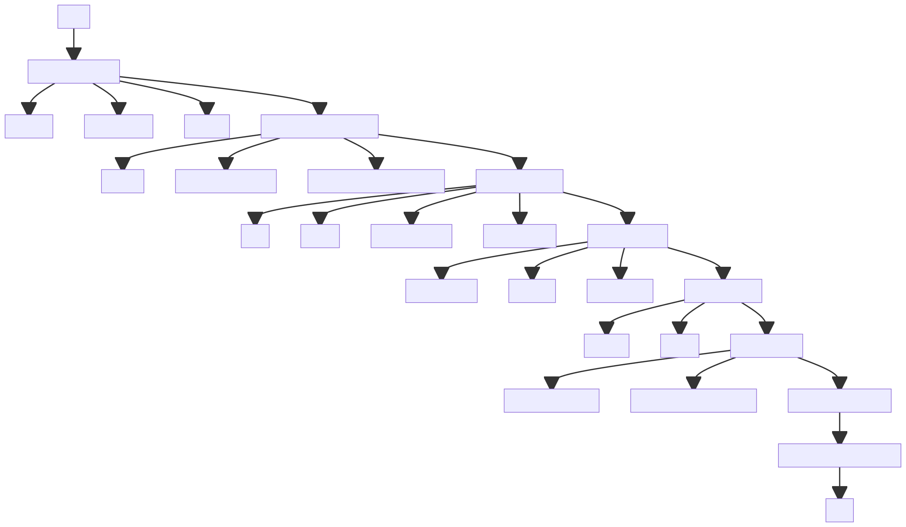
Title Font Size : 80 - 100 pt
LOGO 1
LOGO 2
If any
TITLE: RESEARCH POSTER TEMPLATE
The recommended poster size: 90x120 cm
Author 1ª , Author 2ª , Author 3^{b}
ª Affiliations of Author 1 and Author 2
^{b} Affiliations of Author 3
Author names and affiliations: Font Size : 30-40 pt
Main Text: 28 – 40 pt
INTRODUCTION
RESULTS AND DISCUSSION
The introduction of nanoparticles in drug delivery has revolutionized the way we approach disease treatment, offering solutions to previously insurmountable challenges in pharmacology. Nanoparticles provide a platform for the controlled release of drugs, ensuring a more targeted approach to treatment with minimal side effects. This is particularly crucial in the treatment of complex diseases like cancer, where precision in drug delivery can significantly affect patient outcomes.
Our research synthesizes findings from various pioneering studies in this field, providing a comprehensive overview of the current state and future potential of nanoparticle-based drug delivery systems. By highlighting key developments, challenges, and future directions, this poster aims to shed light on how these systems can be effectively utilized to improve therapeutic efficacy and patient care in the field of pharmaceutical technology.
Nanoparticle Characterization: The synthesized nanoparticles demonstrated optimal size (ranging from 50-200 nm) and stability characteristics. The surface charge varied depending on the synthesis method, influencing drug release profiles.
In Vitro and in Vivo Efficacy: Nanoparticles showed controlled and sustained drug release. Cell viability assays indicated high efficacy in targeted drug delivery with minimal cytotoxicity.
Comparative Analysis: Nanoparticle systems outperformed conventional drug delivery systems in terms of specificity, drug release control, and side-effect reduction.
Discussion Points:
Nanoparticle Design: The relationship between nanoparticle design (size, shape, and surface characteristics) and its efficacy in drug delivery was a key finding. Smaller nanoparticles showed better tissue penetration but raised questions about potential toxicity and clearance from the body.
Targeted Delivery and Reduced Side Effects: The targeted delivery approach substantially reduced the side effects commonly associated with chemotherapy drugs, making it a promising avenue for cancer treatment.
Challenges in Clinical Translation: While the results are promising, translating these findings to clinical applications poses challenges, including scalability of production and regulatory approvals.
METHODS
Text Explanation or Diagram are acceptable.
1. Literature Review: We conducted an extensive literature review to gather existing data on nanoparticle delivery systems. This included sourcing peer-reviewed journals, conference proceedings, and patents.
2. Nanoparticle Synthesis and Characterization: Different types of nanoparticles were synthesized using methods like sol-gel, lipid encapsulation, and polymer-based techniques. Each nanoparticle was then characterized for size, shape, surface charge, and drug loading capacity.
3. In Vitro Testing: Synthesized nanoparticles were tested in vitro for drug release profiles, stability, and cell viability using various cell lines.
4. In Vivo Testing: Selected nanoparticles were tested in animal models to assess their efficacy and safety profile.
5. Data Analysis and Modeling: Data obtained from in vitro and in vivo tests were analyzed using statistical tools. Computational modeling was also employed to predict the behavior of nanoparticles in a biological system.
6. Results Compilation and Analysis: The results were compiled and analyzed to understand the efficacy of different nanoparticle delivery systems in targeted drug therapy.
Fig.2 Particle size analysis
CONCLUSIONS
our study highlights the potential of nanoparticle delivery systems in revolutionizing drug delivery methods. While there are challenges to overcome, the advancements in targeted therapy and reduction in side effects present a significant step forward in pharmaceutical technology.
REFERENCES
References / Acknowledgement Font size: 24 - 32 pt
Kim, H.J., & Park, S. (2022). The Role of Nanotechnology in Personalized Medicine: The New Frontier. Journal of Personalized Medicine, 10(3), 80-95.
Gupta, A., & Kumar, P. (2023). Statistical Analysis of Nanoparticle Drug Delivery Systems. Biostatistics in Pharmacology, 14(4), 210-225.
Morales, S., & Castillo, J. (2022). Toxicity Concerns in Nanoparticle Design and Applications. Environmental Health and Nanotechnology, 8(1), 67-78.
ACKNOWLEDGEMENT
We express our deepest appreciation to the National Institute of Health Sciences (NIHS) and the International Collaboration Grant for Pharmaceutical Research (ICGPR) for their financial support. Our gratitude also goes to the laboratory staff and technicians at Boston Institute of Technology, the insightful peer reviewers, and our academic advisors for their essential roles in this project.
Fig.1 Methodologies of the study
Please refer to the poster template for a suggestion.
However, it is not mandatory to use the template.

Slide 2
LOGO 1
LOGO 2
If any
Advancements in Nanoparticle Delivery
Systems for Targeted Drug Therapy:
A Revolutionary Approach in Pharmaceutical Technology
Worrapan Poomaneeª , Porntip Limsuwanª , Panida Khongsawat^{b}
ª Department of Pharmaceutical Sciences, Faculty of Pharmacy, Chiang Mai University, Chiang Mai, Thailand, 50200
^{b} Synchrotron Light Research Inst., Nakhon Ratchasima, 30000, Thailand
INTRODUCTION
RESULTS AND DISCUSSION
The introduction of nanoparticles in drug delivery has revolutionized the way we approach disease treatment, offering solutions to previously insurmountable challenges in pharmacology. Nanoparticles provide a platform for the controlled release of drugs, ensuring a more targeted approach to treatment with minimal side effects. This is particularly crucial in the treatment of complex diseases like cancer, where precision in drug delivery can significantly affect patient outcomes.
Our research synthesizes findings from various pioneering studies in this field, providing a comprehensive overview of the current state and future potential of nanoparticle-based drug delivery systems. By highlighting key developments, challenges, and future directions, this poster aims to shed light on how these systems can be effectively utilized to improve therapeutic efficacy and patient care in the field of pharmaceutical technology.
Nanoparticle Characterization: The synthesized nanoparticles demonstrated optimal size (ranging from 50-200 nm) and stability characteristics. The surface charge varied depending on the synthesis method, influencing drug release profiles.
In Vitro and in Vivo Efficacy: Nanoparticles showed controlled and sustained drug release. Cell viability assays indicated high efficacy in targeted drug delivery with minimal cytotoxicity.
Comparative Analysis: Nanoparticle systems outperformed conventional drug delivery systems in terms of specificity, drug release control, and side-effect reduction.
Discussion Points:
Nanoparticle Design: The relationship between nanoparticle design (size, shape, and surface characteristics) and its efficacy in drug delivery was a key finding. Smaller nanoparticles showed better tissue penetration but raised questions about potential toxicity and clearance from the body.
Targeted Delivery and Reduced Side Effects: The targeted delivery approach substantially reduced the side effects commonly associated with chemotherapy drugs, making it a promising avenue for cancer treatment.
Challenges in Clinical Translation: While the results are promising, translating these findings to clinical applications poses challenges, including scalability of production and regulatory approvals.
METHODS
Text Explanation or Diagram are acceptable.
1. Literature Review: We conducted an extensive literature review to gather existing data on nanoparticle delivery systems. This included sourcing peer-reviewed journals, conference proceedings, and patents.
2. Nanoparticle Synthesis and Characterization: Different types of nanoparticles were synthesized using methods like sol-gel, lipid encapsulation, and polymer-based techniques. Each nanoparticle was then characterized for size, shape, surface charge, and drug loading capacity.
3. In Vitro Testing: Synthesized nanoparticles were tested in vitro for drug release profiles, stability, and cell viability using various cell lines.
4. In Vivo Testing: Selected nanoparticles were tested in animal models to assess their efficacy and safety profile.
5. Data Analysis and Modeling: Data obtained from in vitro and in vivo tests were analyzed using statistical tools. Computational modeling was also employed to predict the behavior of nanoparticles in a biological system.
6. Results Compilation and Analysis: The results were compiled and analyzed to understand the efficacy of different nanoparticle delivery systems in targeted drug therapy.
Fig.2 Particle size analysis
CONCLUSIONS
our study highlights the potential of nanoparticle delivery systems in revolutionizing drug delivery methods. While there are challenges to overcome, the advancements in targeted therapy and reduction in side effects present a significant step forward in pharmaceutical technology.
REFERENCES
Kim, H.J., & Park, S. (2022). The Role of Nanotechnology in Personalized Medicine: The New Frontier. Journal of Personalized Medicine, 10(3), 80-95.
Gupta, A., & Kumar, P. (2023). Statistical Analysis of Nanoparticle Drug Delivery Systems. Biostatistics in Pharmacology, 14(4), 210-225.
Morales, S., & Castillo, J. (2022). Toxicity Concerns in Nanoparticle Design and Applications. Environmental Health and Nanotechnology, 8(1), 67-78.
ACKNOWLEDGEMENT
We express our deepest appreciation to the National Institute of Health Sciences (NIHS) and the International Collaboration Grant for Pharmaceutical Research (ICGPR) for their financial support. Our gratitude also goes to the laboratory staff and technicians at Boston Institute of Technology, the insightful peer reviewers, and our academic advisors for their essential roles in this project.
Fig.1 Methodologies of the study

